Slide 1
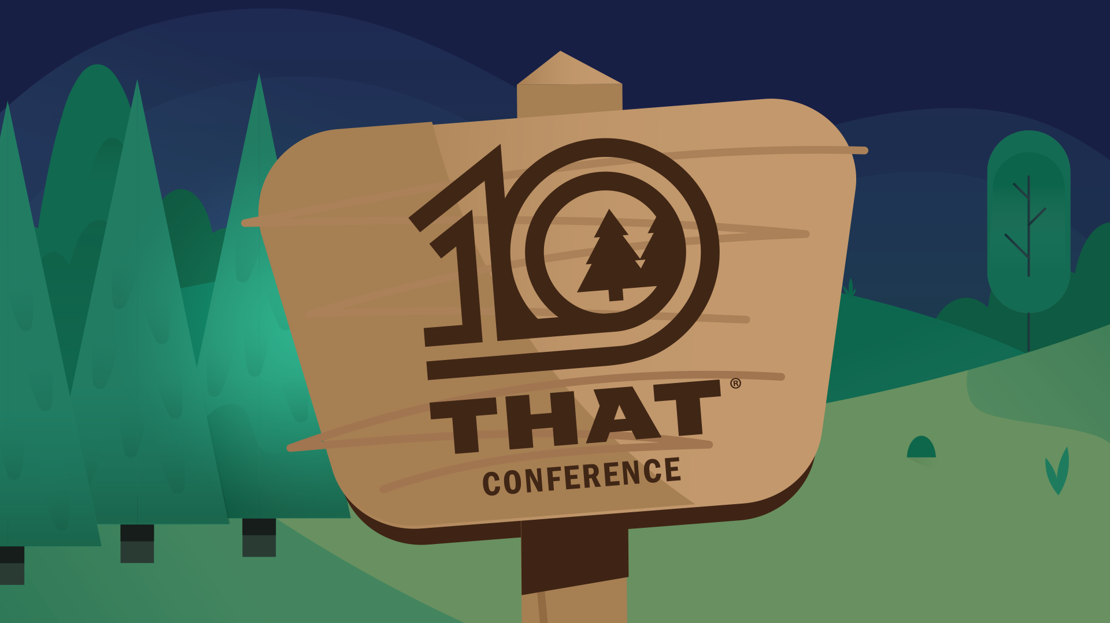

Slide 2
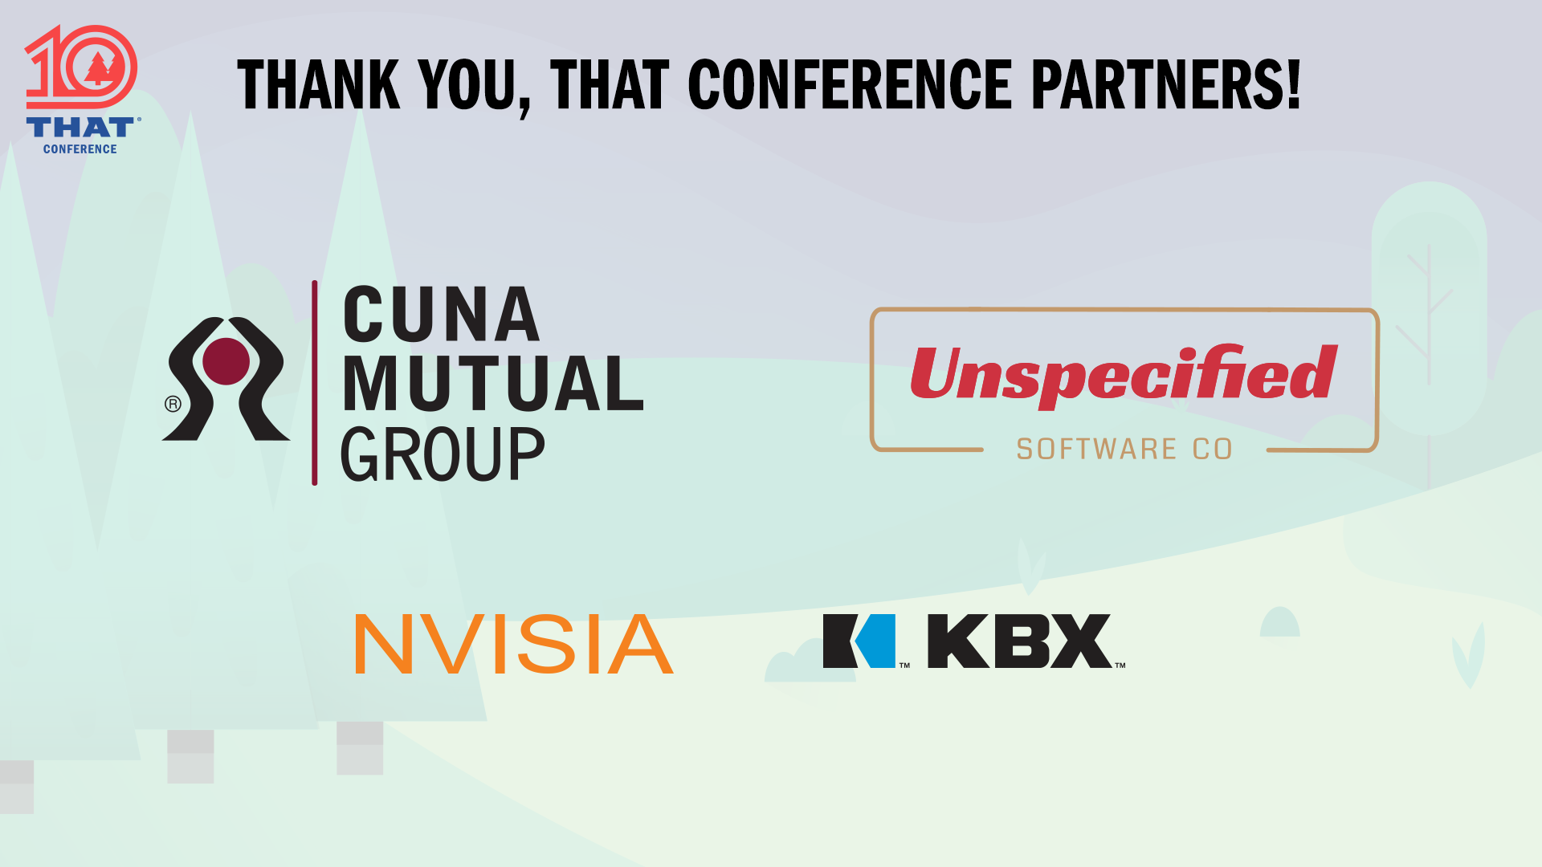

Slide 3
About Centare
Digital Business and Technology consulting firm based in Milwaukee & Madison
Founded 1999
100+ Full Time team members
Product Management & Strategy
Software Engineering
Quality Assurance
User Experience & Design
Agile Methodologies
DevOps
Notes:
External 1k referral bonus.
If you friend complains, send them to us
Centare.com
Locations
MKE
Madison
Remote
.NET, Java, Product Managers, QA/QE, DevOps

Slide 4
Building Event-Driven Applications Using Azure
Dustin Ewers
Centare
www.dustinewers.com
https://www.linkedin.com/in/dustinewers/
https://github.com/DustinEwers/event-driven-arch-azure

Slide 5
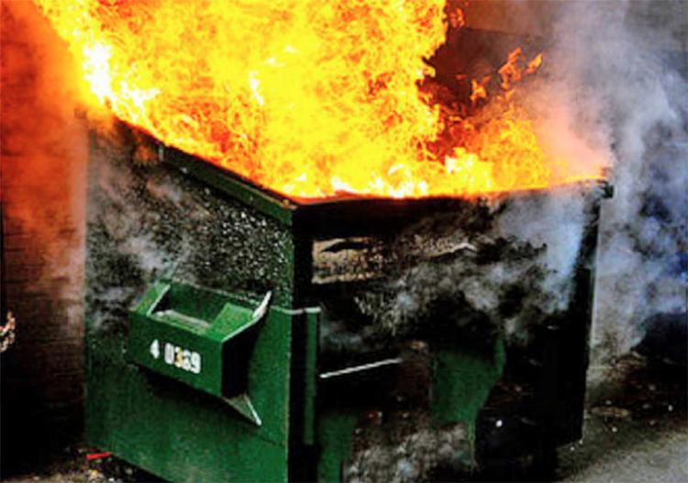
Our story begins…
Notes:
Got called onto to work on an app
That app was a mess | one run of a batch process brought down a whole database server
Used all the threads, but that left no threads for other things
Fixed the mess with event driven architecture
Sometimes the common stuff doesn’t work
Went from over a day to ~15 minutes

Slide 6
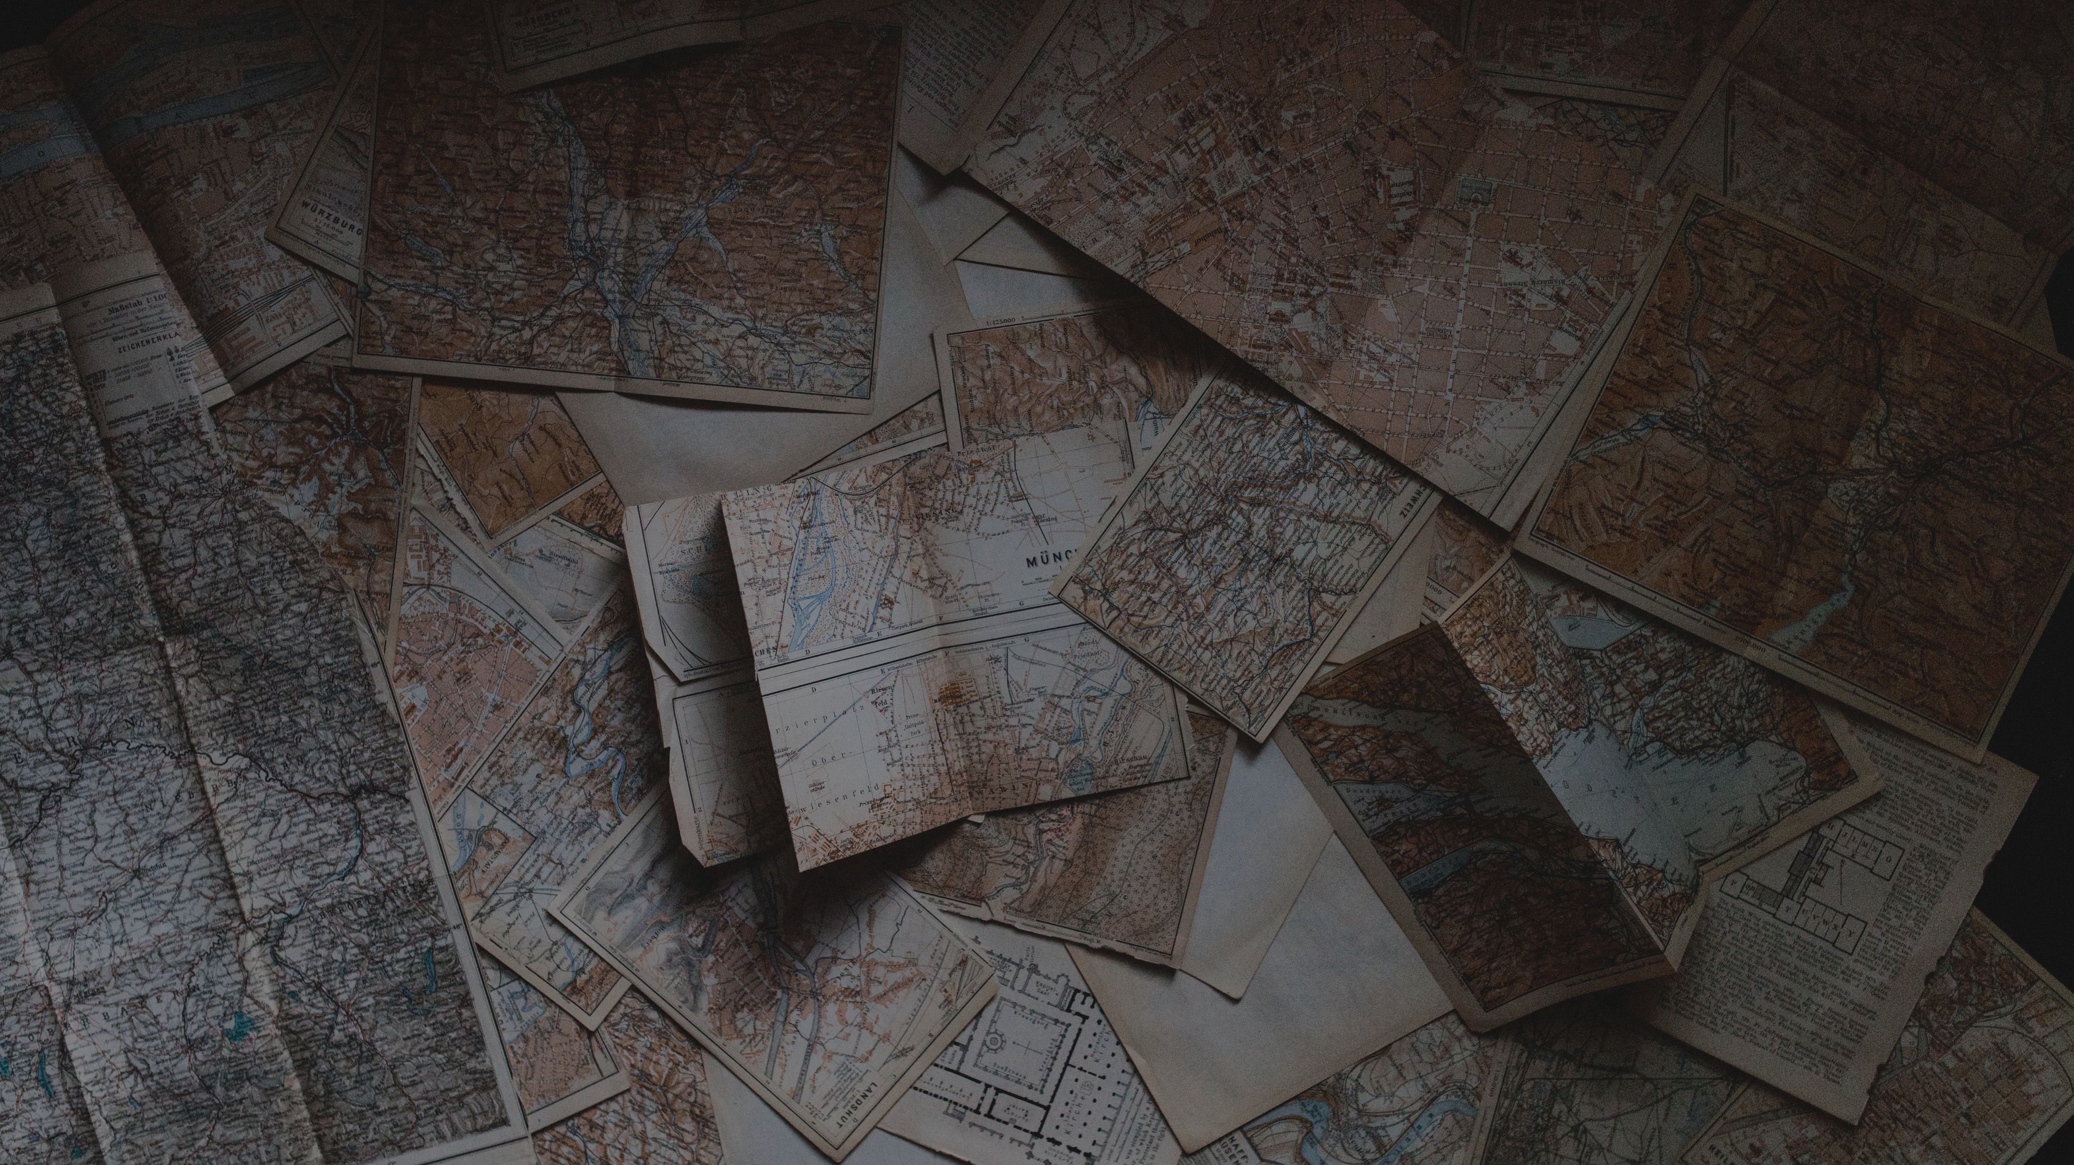
Roadmap
What is Event Driven Architecture?
When is it useful?
How to implement it?
Notes:
Photo by Andrew Neel on Unsplash

Slide 7
What is Event Driven Architecture?
and why should I care?
Notes:
Event driven architecture is a component-based architecture where communication between components is handled by discrete messages (aka, events).
Component Orientation
Event Based Interaction Model
Now let’s talk about a useful definition…
I want to talk about a couple scenarios…
Using events to decouple microservices
Using events to monitor changes in state or streams of data

Slide 8
Scenario 1: Monolith to Microservices
Notes:
Big giant app into smaller easier to manage apps
Microservice = small API or application with its own data store.

Slide 9
Product Service
Customer Service
Order Service
Notes:
Scenario:
Customer Needs Their Order History
-------
Customer Service for customer data
Order Service for Order data
Product Service for Product data

Slide 10
Notes:
Multiple entanglements, so each area relies on someone else
Let’s a say we create a new customer
Distributed monolith… just like a regular monolith, but slower.

Slide 11
Scenario 2: Long Running Processes
Payment Gateways
Binding Insurance Policies
Talking to Ancient Backend Systems
Reports
PDF/Video/Image Conversion
Batch Processes
Notes:
Things we would normally batch out

Slide 12
Scenario 3: Inventories and Ledgers
History tracking is a must
Need to reduce conflicts from large numbers of potential users

Slide 13
Scenario 4: Data Flows
Sensor readings
Telemetry

Slide 14
What do these things have in common?
Notes:
Answer: Events
Component Orientation
Event Based Interaction Model
Event Driven Architecture is an architecture that deals with events

Slide 15
Components
Events
Producers
Message Brokers
Consumers

Slide 16
Consumer
Producer
Message Broker
Consumer
Consumer
Events

Slide 17
Customer Service
Message Broker
Order Service
Notes:
This doesn’t mean that producers are only producers and consumer are only consumers. The lines of communication can and often do go both ways.

Slide 18
What is an event?
Notable thing that happens
Lightweight
Easily Understood
Notes:
Ideally defined in business terms, not technology terms
Events should be understood by people
Notable thing that happens
Changes in state
New Customer
Temperature Reading
Shopping Cart Checkout
Lightweight
Easily Understood

Slide 19
Event Patterns
Queues
Topics
Event Sourcing
Event Streaming

Slide 20
Scaling with Queues
Load Leveling
Alter processors to control flow rate
Processor
1
Queue
Processor
Add or subtract
processors as needed
2
4
5
6
Processor
3
Notes:
Kubernetes – can auto scale
Or you can have queue-based scaling mechanisms
Or you can use queuing on prem to not destroy your on prem infrastructure

Slide 21
Decoupling Apps with Topics
Promote loosely coupled architecture
Easy to add consumers later
Subscriber
Customer Service
Customer Update Topic
Subscriber
Subscriber
Notes:
Without the topic, the Customer Service needs to keep track of all the calling services it needs to call to update them on the customer.
With the topic, the Customer Service just needs to do one thing

Slide 22
How to do it?
Azure
Others
Azure Service Bus
Topics
Queues
Azure Event Grid
Orchestrate Azure Events
Pub/Sub
AWS Simple Notification Service (SNS)
Rabbit MQ
DIY
Notes:
https://docs.microsoft.com/en-us/azure/service-bus-messaging/service-bus-premium-messaging
Premium vs. Standard
Premium is faster and has guaranteed resources.
It also supports security scenarios like Vnets
It’s also super expensive

Slide 23
Service Bus APIs
Azure.Messaging.ServiceBus (New)
Microsoft.Azure.ServiceBus
WindowsAzure.ServiceBus (Old)
Notes:
You’re going to find links to each of these in the docs. It’s kind of annoying…
https://github.com/Azure/azure-sdk-for-net/blob/Azure.Messaging.ServiceBus_7.0.0/sdk/servicebus/Azure.Messaging.ServiceBus/README.md

Slide 24
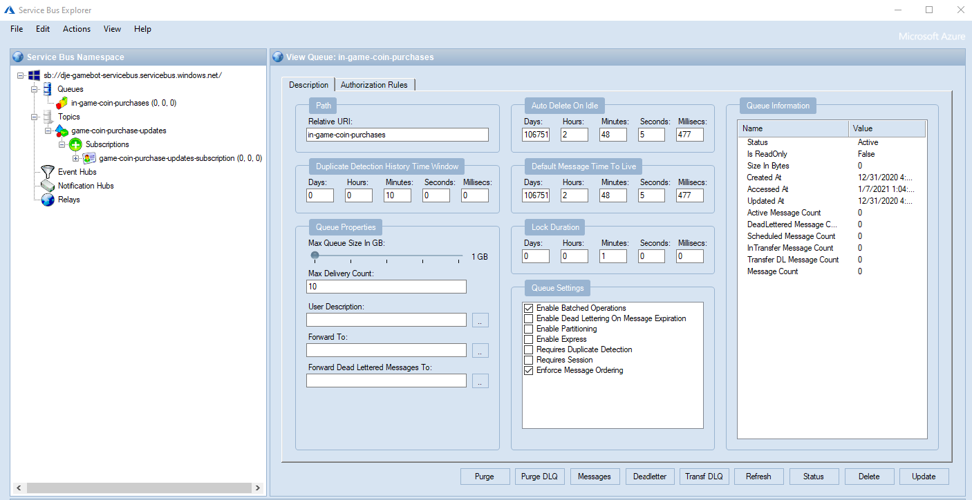
Notes:
You can also use the portal now https://github.com/paolosalvatori/ServiceBusExplorer/releases/tag/5.0.1

Slide 25
Event Sourcing
Append only
Replay events for state
Materialized Views
Easy to track history
Deposit $100.00
Withdraw $10.00
Withdraw $20.00
Account Balance $70.00
Notes:
https://docs.microsoft.com/en-us/azure/architecture/patterns/event-sourcing Event Sourcing
– events are kept and can be replayed for state (think accounting)
Good for data that needs history and auditing
Good for data that has lots of people adding to it, like inventories
You don’t need anything special to do this, it’s just about how you store your data.

Slide 26
Event Streaming
IOT
Telemetry
Notes:
Event Streaming – streams of information, often used in IOT

Slide 27
How to do it?
Azure
Others
Azure IOT Hub
Azure Event Hub
AWS Kinesis
Google Dataflow
Apache Kafka
Notes:
https://docs.microsoft.com/en-us/azure/service-bus-messaging/service-bus-premium-messaging
https://docs.microsoft.com/en-us/azure/architecture/aws-professional/services

Slide 28
Pitfalls

Slide 29
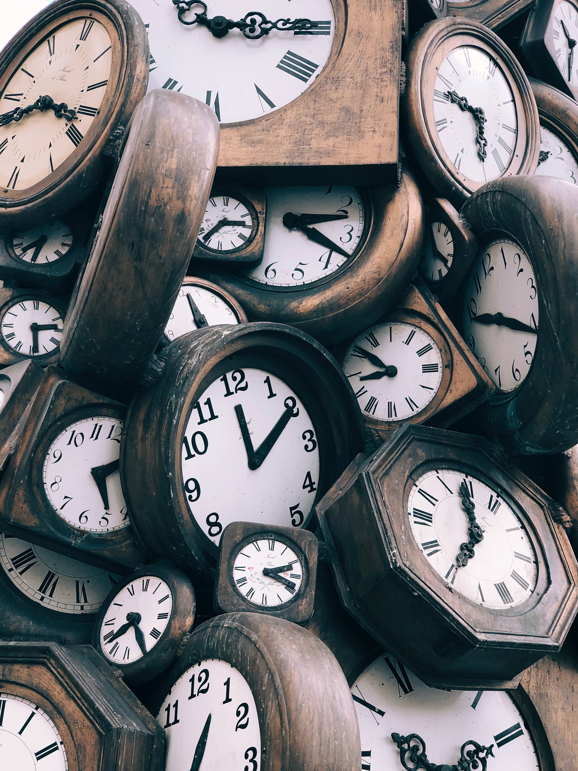
Breaking the Space-Time Continuum
Consistency Problems
Event Delivery Failures
Multiple processing of events
Notes:
Consistency Problems – Eventual consistency | you can’t post and then retrieve
Event Delivery Failures – Sometimes events don’t get where they need to go
Multiple processing of events – Sometimes you get more than one event, make your services Idempotent
Photo by Jon Tyson on Unsplash
https://unsplash.com/photos/FlHdnPO6dlw

Slide 30
Logging & Tracking Events
User Action
Producer
Message Broker
Event Processor
User Action
CorrelationId: 42
Producer
CorrelationId: 42
Message Broker
CorrelationId: 42
Event Processor
CorrelationId: 42

Slide 31
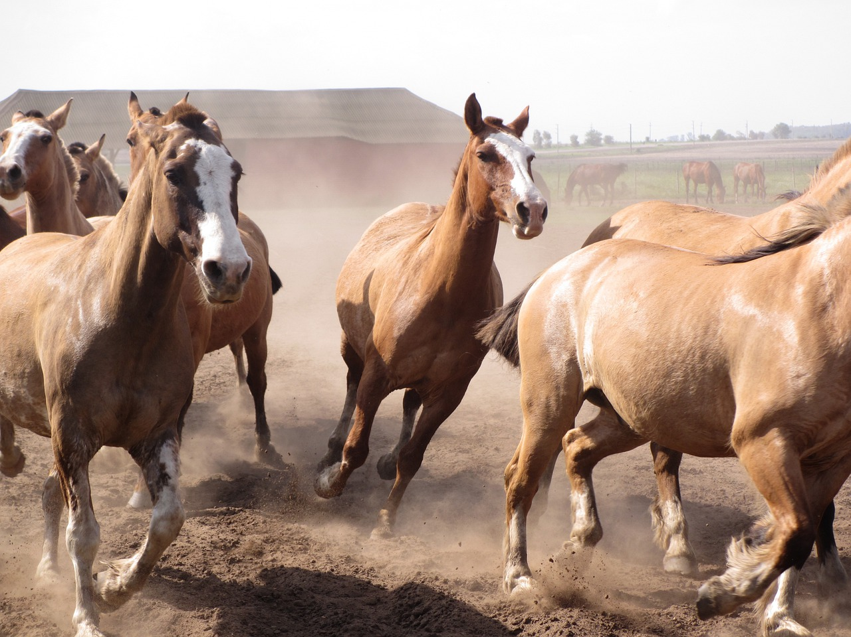
Thundering Herd Problem
Notes:
Thundering Herd – one service update triggers a bunch of callbacks to the OG service
Image by <a href="https://pixabay.com/users/annaleyah-9488006/?utm_source=link-attribution&amp;utm_medium=referral&amp;utm_campaign=image&amp;utm_content=4212301">annaleyah</a> from <a href="https://pixabay.com/?utm_source=link-attribution&amp;utm_medium=referral&amp;utm_campaign=image&amp;utm_content=4212301">Pixabay</a>
https://pixabay.com/photos/horses-argentina-gaucho-ranch-4212301/

Slide 32
Fallacies of Distributed Computing
The network is reliable
Latency is zero
Bandwidth is infinite
The network is secure
Topology doesn't change
There is one administrator
Transport cost is zero
The network is homogeneous
Notes:
Events don’t have to be distributed, but they often are.
https://en.wikipedia.org/wiki/Fallacies_of_distributed_computing
The fallacies of distributed computing are a set of assertions made by L Peter Deutsch and others at Sun Microsystems describing false assumptions that programmers new to distributed applications invariably make.

Slide 33
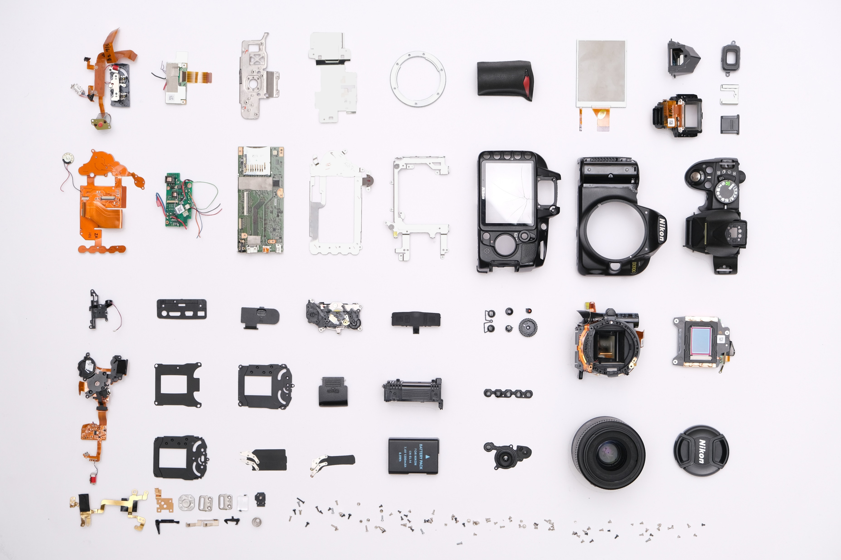
Notes:
Complexity Make sure you’re getting something for your complexity
A lot of people
Photo by Kei Scampa from Pexels

Slide 34

Notes:
Final Lesson:
Don’t use these patterns because you want to look smart and flex those big brain muscles.
Do it because it solves an actual problem.
https://www.pexels.com/photo/strict-female-teacher-with-book-pointing-at-scribbled-blackboard-3771074/
Photo by Andrea Piacquadio from Pexels

Slide 35
Demo – Payment API
Service Bus Queue
Main Game App
(ASP.NET App)
Payment Process (Function App)
Service Bus Topic
Notes:
Felt this would be less boring than fixing a batch app
This pattern applies to any long running process that needs to be async-ed
Order of Operations:
Infra
App Structure
Data Flow

Slide 36
Building Event-Driven Applications Using Azure
Dustin Ewers
Centare
www.dustinewers.com
https://www.linkedin.com/in/dustinewers/
https://github.com/DustinEwers/event-driven-arch-azure

Slide 37
